Slide 1
Final Project : Student Management
Made By :
-Fauzan
-Aria

Slide 2
A C++ Application : Student Management
Purpose : A data center for any school that is in need for methods of reliable,easy to use,easily modifiable preset data keeping without regard for size.
A data center that can do: record-keeping,etc.
To ensure the simplest and most efficient code building possible we used C++ using .cpp format.

Slide 3
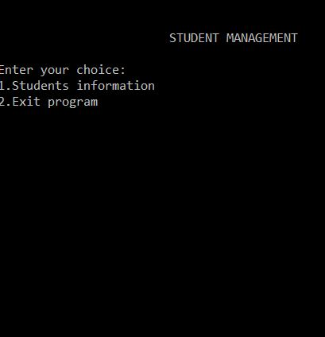
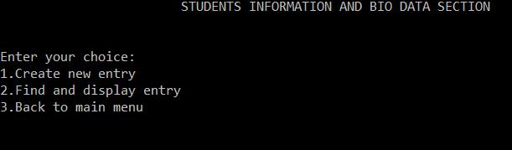
Looks Of The Application

